Slide 1
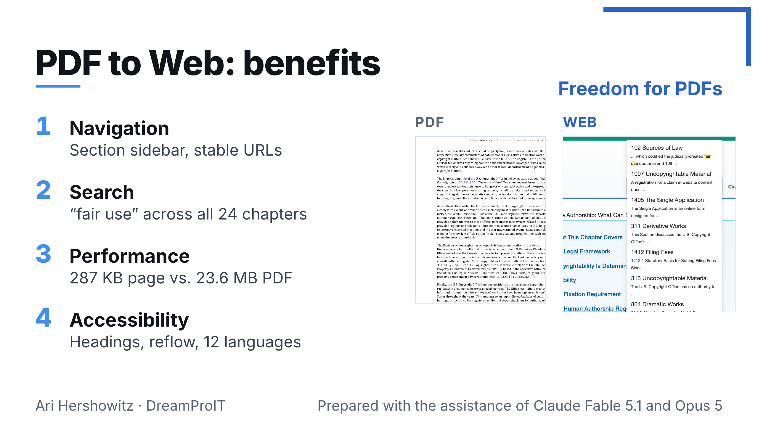
Notes:
PDF to Web: benefits
Freedom for PDFs
1
Navigation
Section sidebar, stable URLs
2
Search
“fair use” across all 24 chapters
3
Performance
287 KB page vs. 23.6 MB PDF
4
Accessibility
Headings, reflow, 12 languages
PDF
WEB
Ari Hershowitz · DreamProIT
Prepared with the assistance of Claude Fable 5.1 and Opus 5

Slide 2
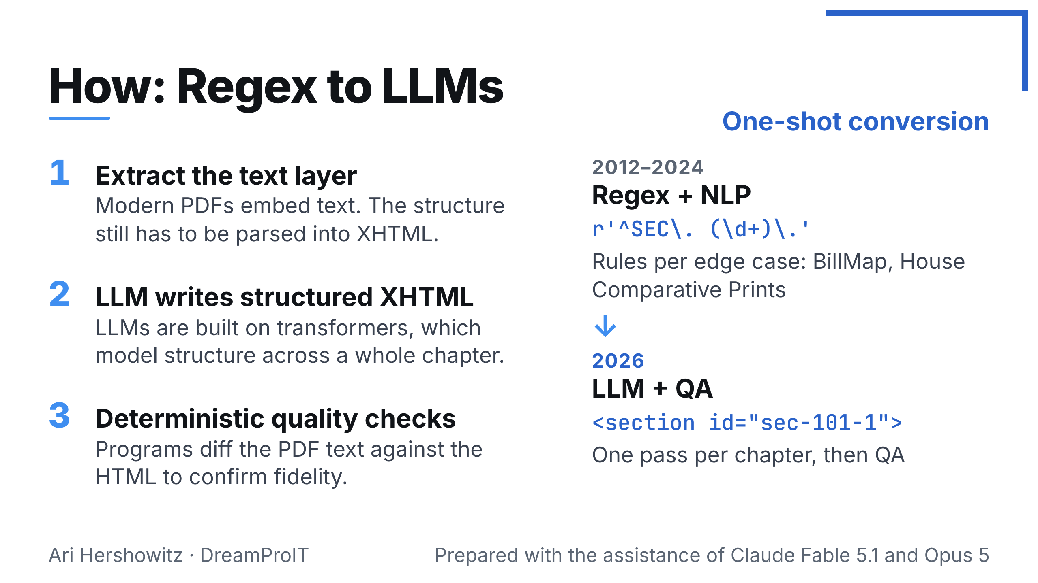
Notes:
How: Regex to LLMs
One-shot conversion
1
Extract the text layer
Modern PDFs embed text. The structure still has to be parsed into XHTML.
2
LLM writes structured XHTML
LLMs are built on transformers, which model structure across a whole chapter.
3
Deterministic quality checks
Programs diff the PDF text against the HTML to confirm fidelity.
2012–2024
Regex + NLP
r'^SEC\. (\d+)\.'
Rules per edge case: BillMap, House Comparative Prints
↓
2026
LLM + QA
<section id="sec-101-1">
One pass per chapter, then QA
Ari Hershowitz · DreamProIT
Prepared with the assistance of Claude Fable 5.1 and Opus 5

Slide 3
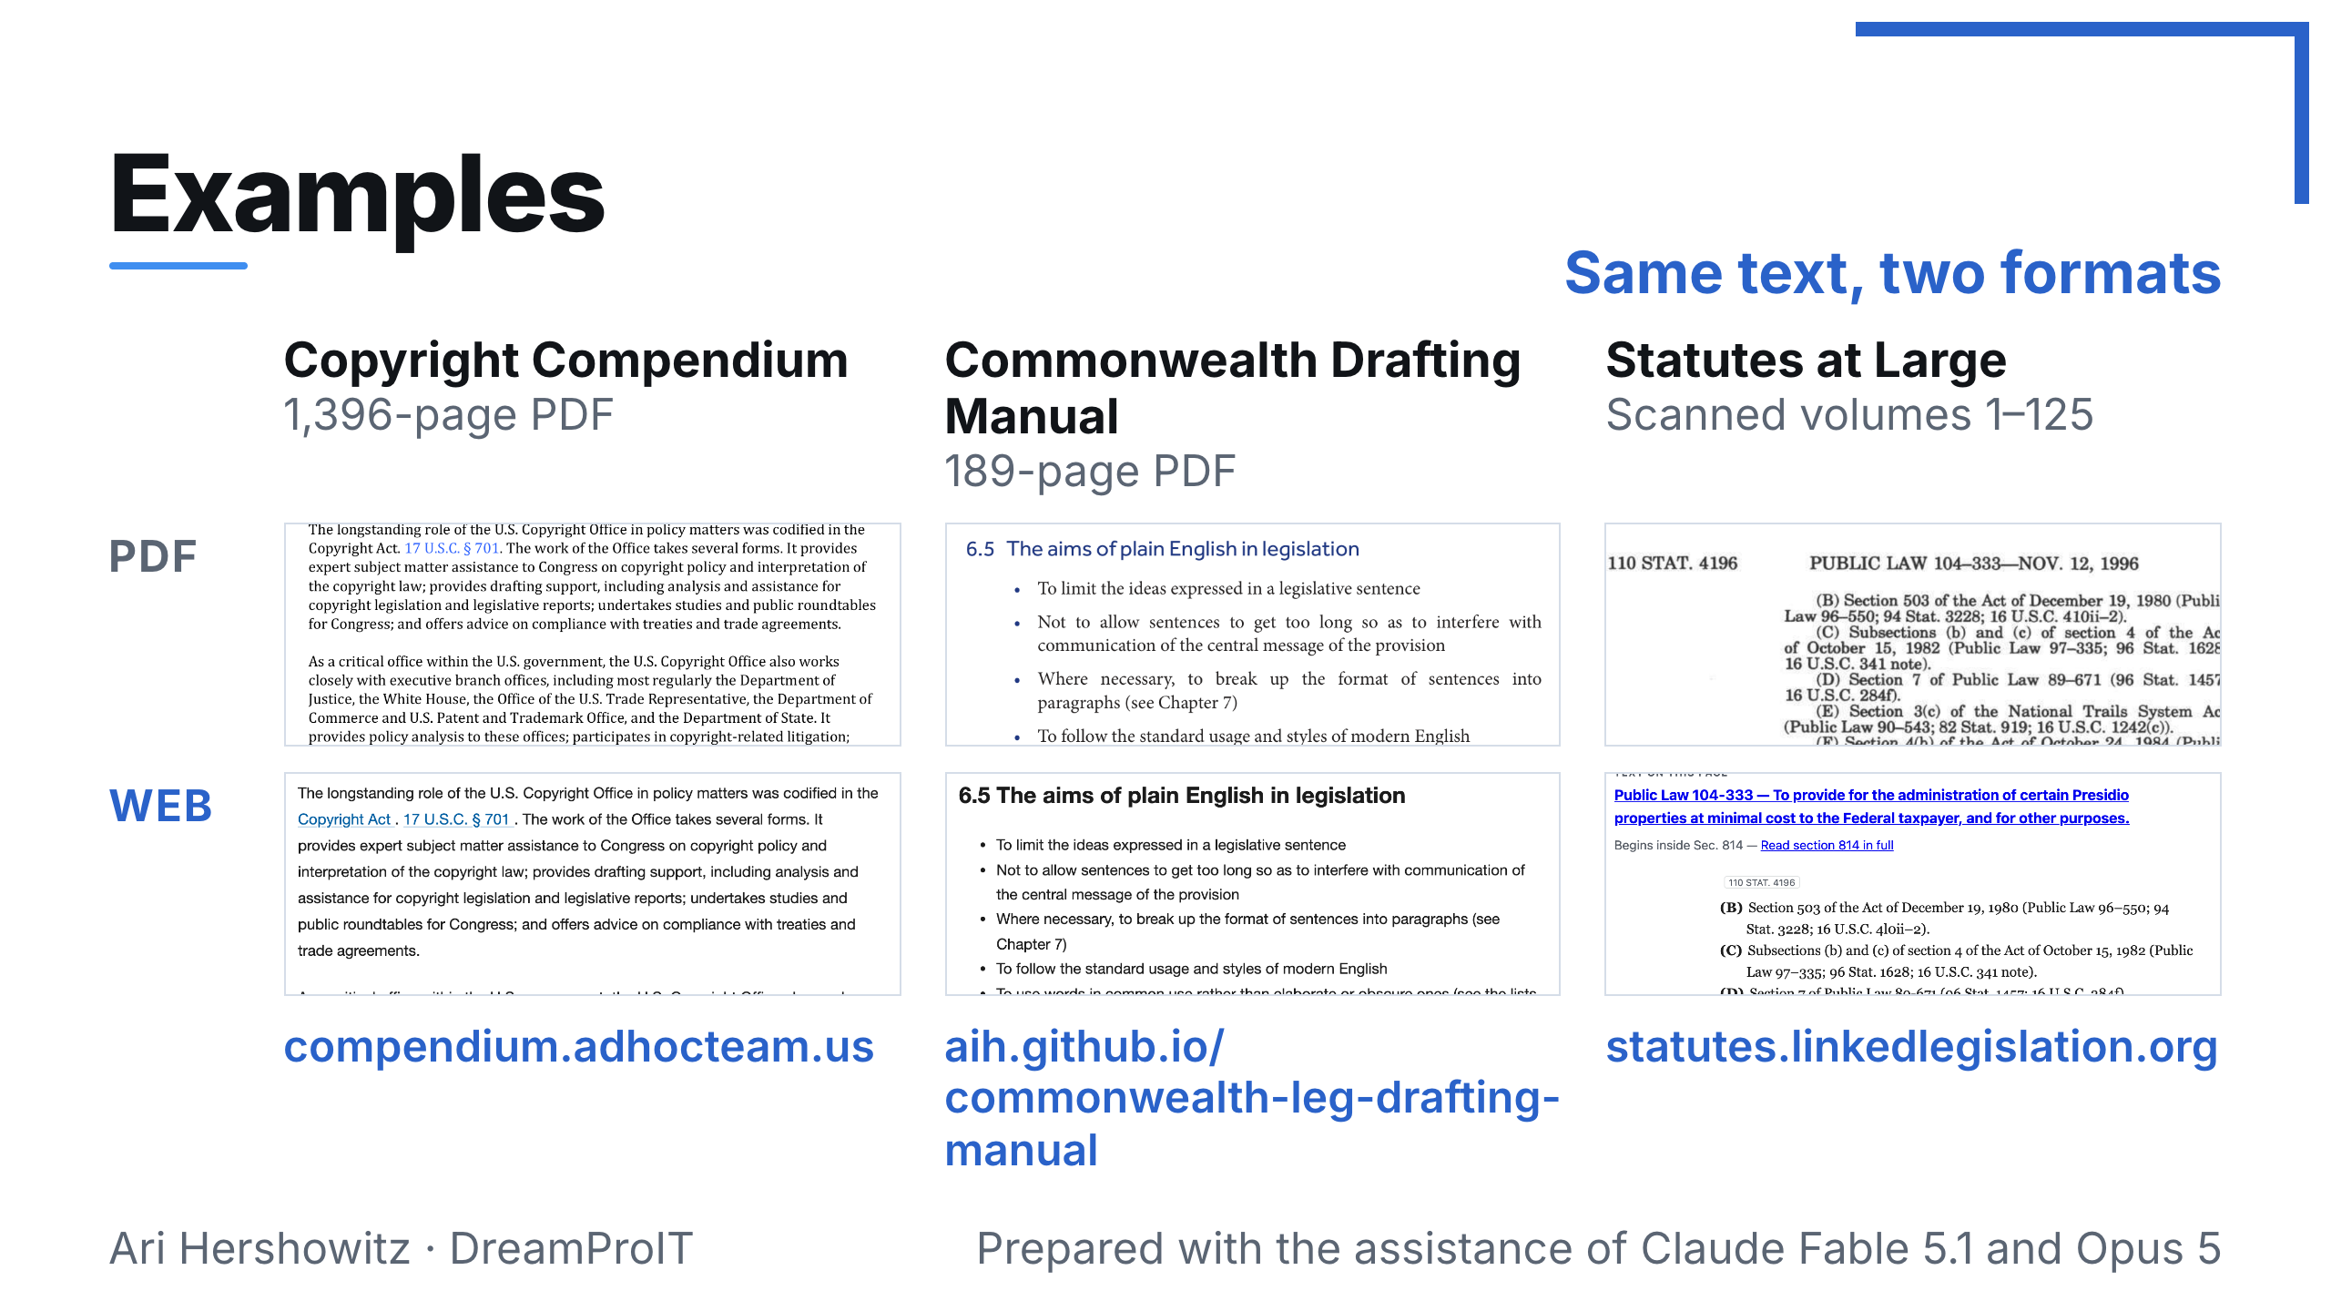
Notes:
Examples
Same text, two formats
Copyright Compendium
1,396-page PDF
Commonwealth Drafting Manual
189-page PDF
Statutes at Large
Scanned volumes 1–125
PDF
WEB
compendium.adhocteam.us
aih.github.io/ commonwealth-leg-drafting-manual
statutes.linkedlegislation.org
Ari Hershowitz · DreamProIT
Prepared with the assistance of Claude Fable 5.1 and Opus 5

